Slide 1
Best method to make money with videogames
Richard, Vikas, jesse

Slide 2
Motivation and Summary
Hypothesis: If you want to make money playing games, your best bet in succeeding is playing Fortnite and streaming it on Twitch.
Social Media and the internet has dominated the current society
Fortnite seems to be the most popular game socially at the moment.
Not only are people just playing the games now, but the current trend now is to watch other people play the games they play
Some people have full time jobs now where they make videos on YouTube or stream on Twitch
Why is Fortnite the most popular game?
We were able to answer these questions but due to the limitation of websites like Twitch, Google, YouTube, Instagram etc. due to privacy reasonings, our findings were not as satisfactory as we would have liked.

Slide 3
Questions and Data
Why is Fortnite the most popular game?
What other game are popular, as popular and more or less popular than Fortnite?
How do me measure how popular a game is?
How popular are Fortnite and other games on Twitch?
The data we needed in order to answer these questions were statistical findings about games
We found the data from Twitch, Twitter and Contextual Web Search APIs

Slide 4
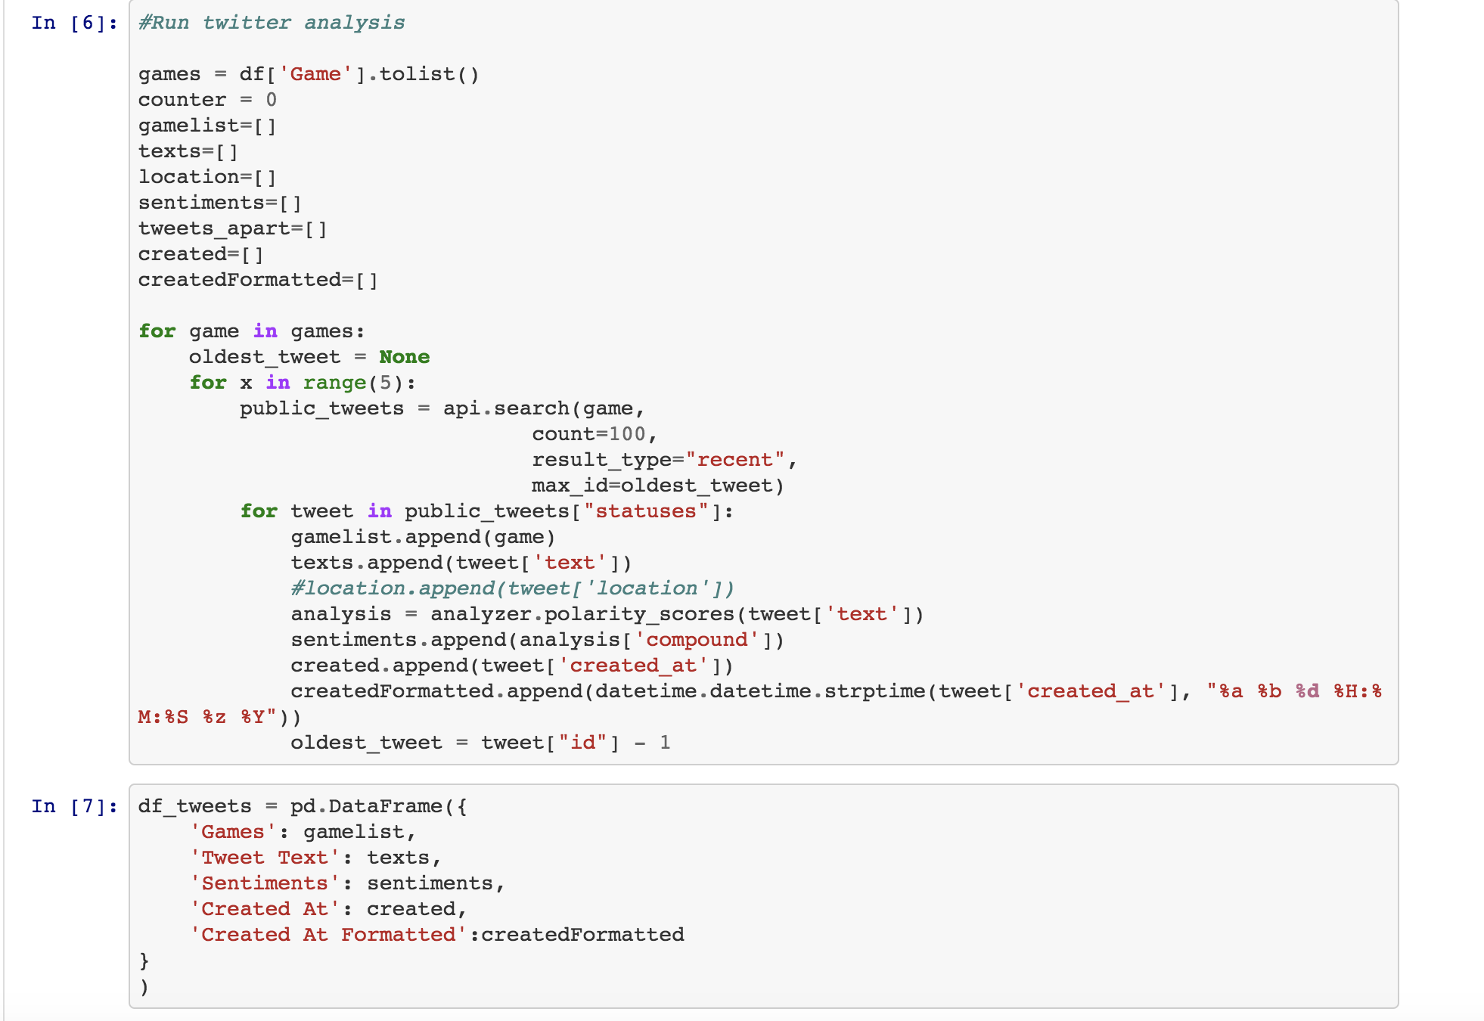
Data Cleanup and Exploration

Slide 5
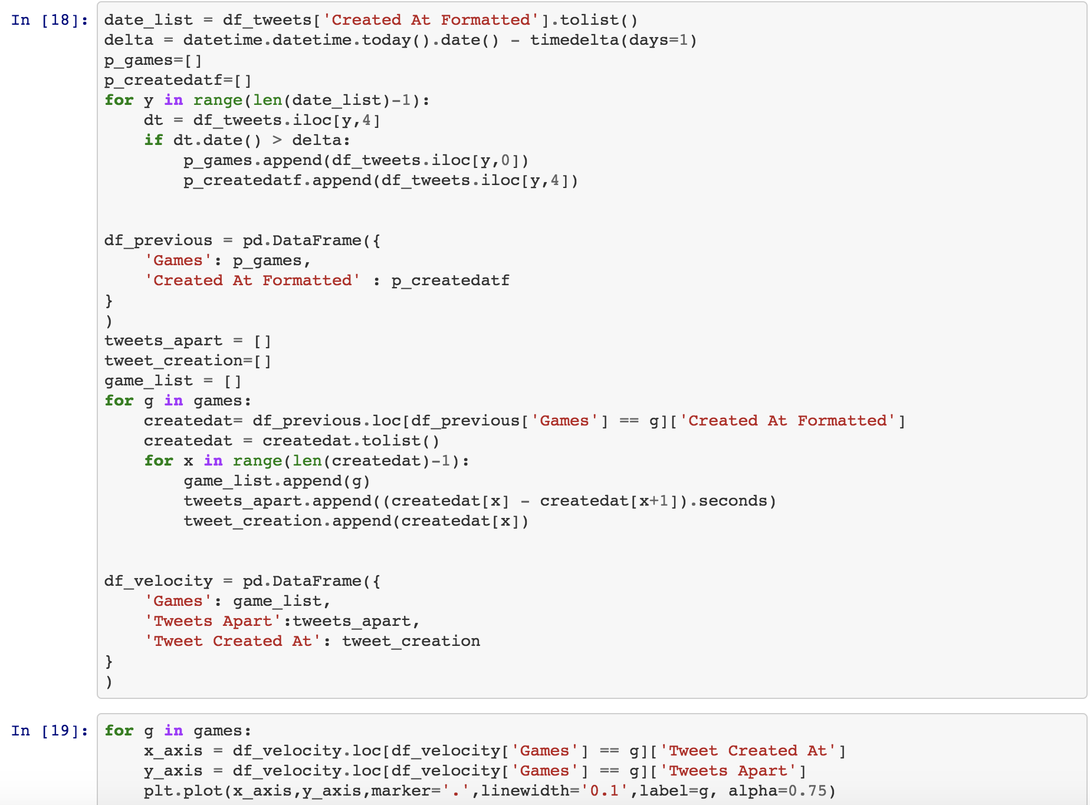
Data Cleanup and Exploration

Slide 6
Data Analysis and Discussion

Slide 7
Data Analysis and Discussion

Slide 8
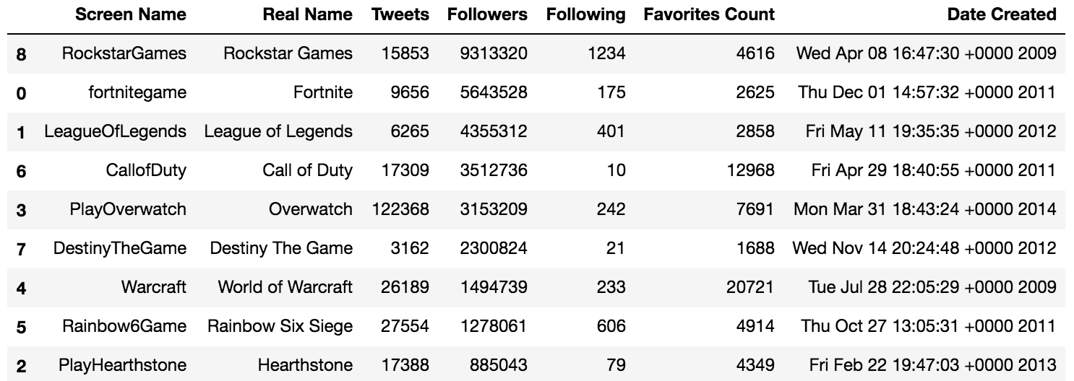
TWITTER

Slide 9
Post Mortem
Privacy Restrictions – Twitch, Google, YouTube, Instagram
Most information like number of downloads or purchases for games were easily found with a simple search and these numbers were not put together in a csv file or attainable from an API reference
Most game API references only provided in game statistics for players instead of statistics about the game
We could not find historical data from previous years
With more time, we would try to gain authorization from popular gamers like Ninja and other gamers and access their information through API on the websites we mentioned before to see how their numbers affect a game’s popularity

Slide 10
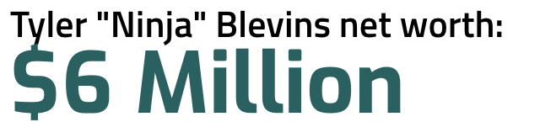
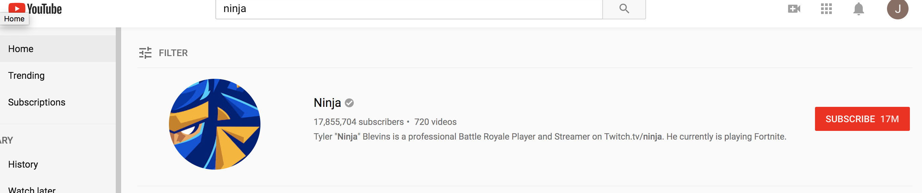
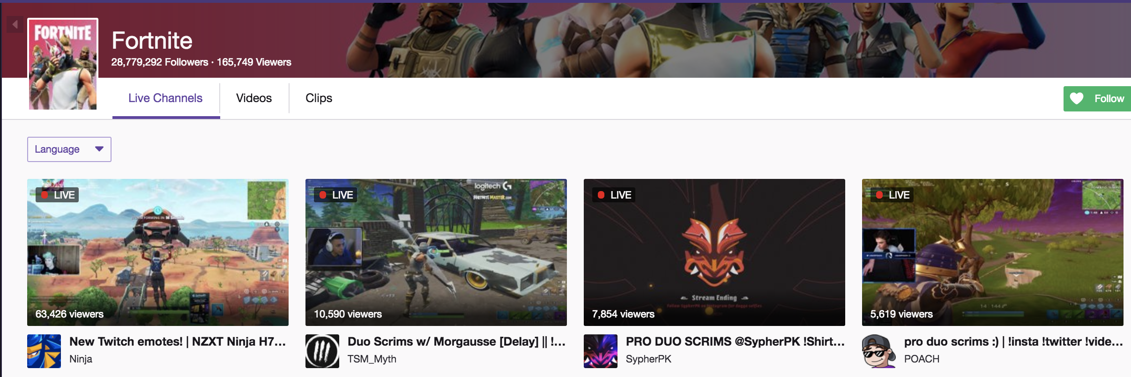


Slide 11
Question Time
??????

